Slide 1

AN Optimal Healthcare Management System
Richard c. Ropac
SWENG 837 Software Design final Project
9 august 2024

Slide 2
Introduction
- This presentation covers the design and implementation of a comprehensive healthcare management system.
- The project aims to address inefficiencies in healthcare operations by providing a unified platform that streamlines key processes such as appointment scheduling, medical record management, payment processing, and prescription handling.

Slide 3
Problem Statement/Business Requirements
Problem Definition:
- Inefficient management of healthcare operations: appointments, records, payments, and prescriptions.
System Functionalities:
- Schedule, view, and manage appointments.
- Update and access patient medical records.
- Process and track payments.
- Prescriptions: Issue and manage prescriptions.
Target Users:
- Patients: Manage appointments, records, and payments.
- Doctors/Nurses: Access/update patient info, issue prescriptions.
- Admin Staff: Oversee scheduling, billing, and coordination.
Business Goals:
- Efficiency: Automate and integrate key processes.
- Patient Care**: Provide timely access to accurate information.
- Security: Protect data and ensure compliance (HIPAA).
- Scalability: Support growing user base.

Slide 4
Non-Functional requirements
Performance:
Support up to 100K concurrent users
< 2 seconds per interaction
Efficient transaction processing
Security:
- Secure user access
- Role-based access control
- Protect data in transit and at rest
Maintainability:
- Easy updates and scaling
- Comprehensive documentation (e.g. User/Training guides)
- Unit, integration, and end-to-end tests
Other Requirements:
- High availability with failover support
- Adherence to healthcare regulations
- User-friendly interface
- 24/7 system access

Slide 5
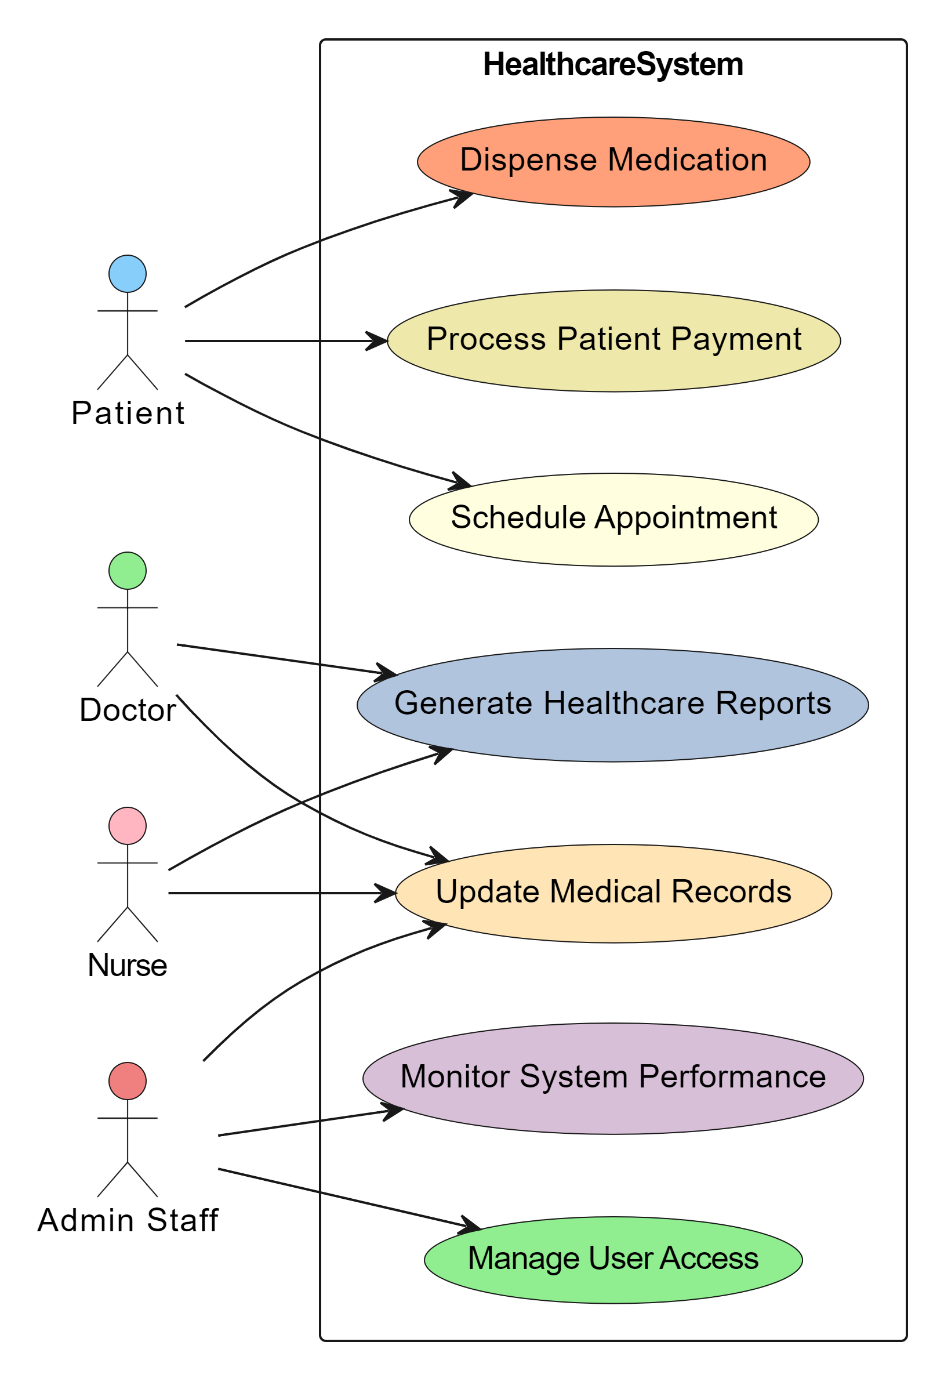
Use case diagram

Slide 6
Domain model

Slide 7
Class diagram

Slide 8
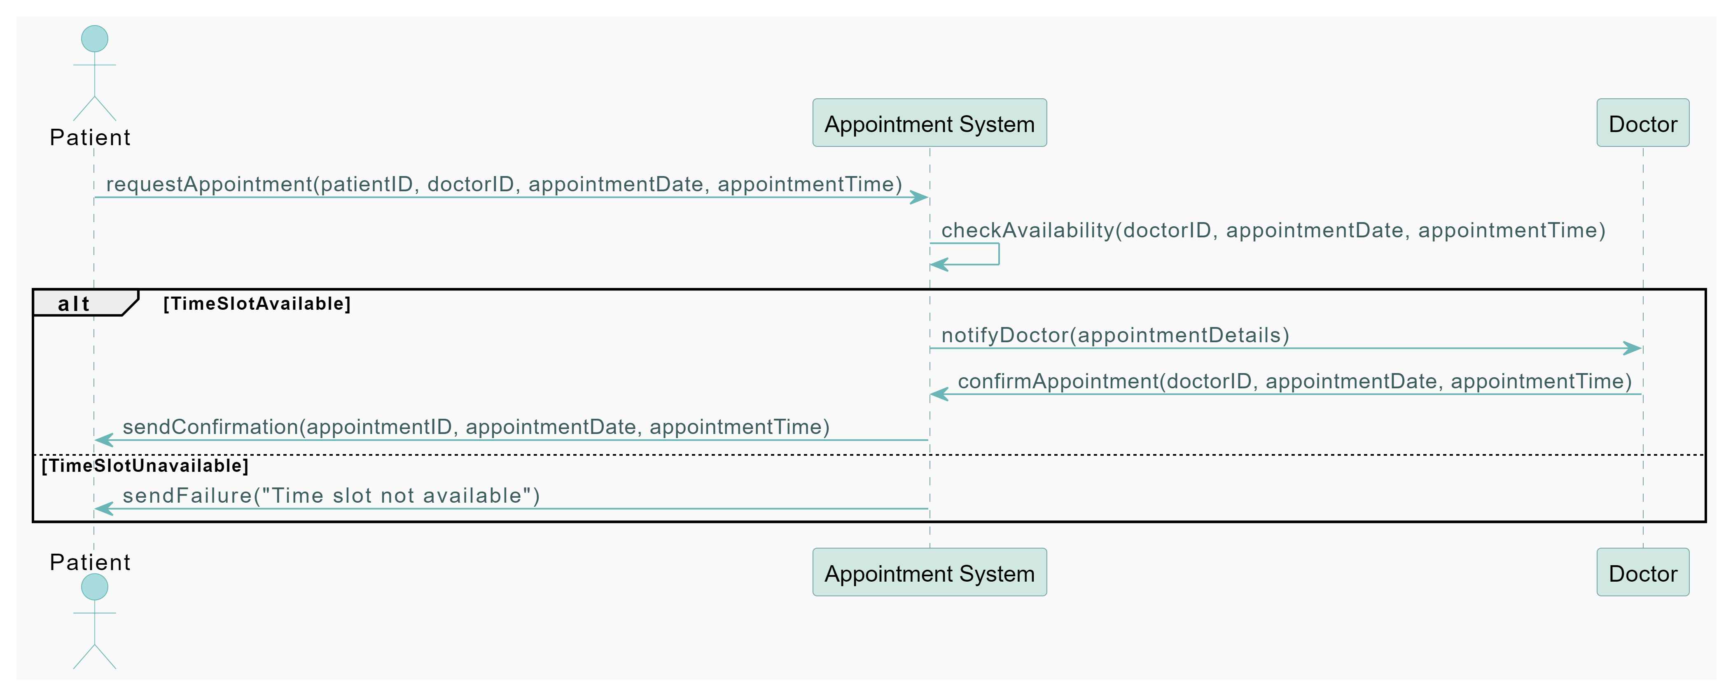
Sequence Diagram

Slide 9
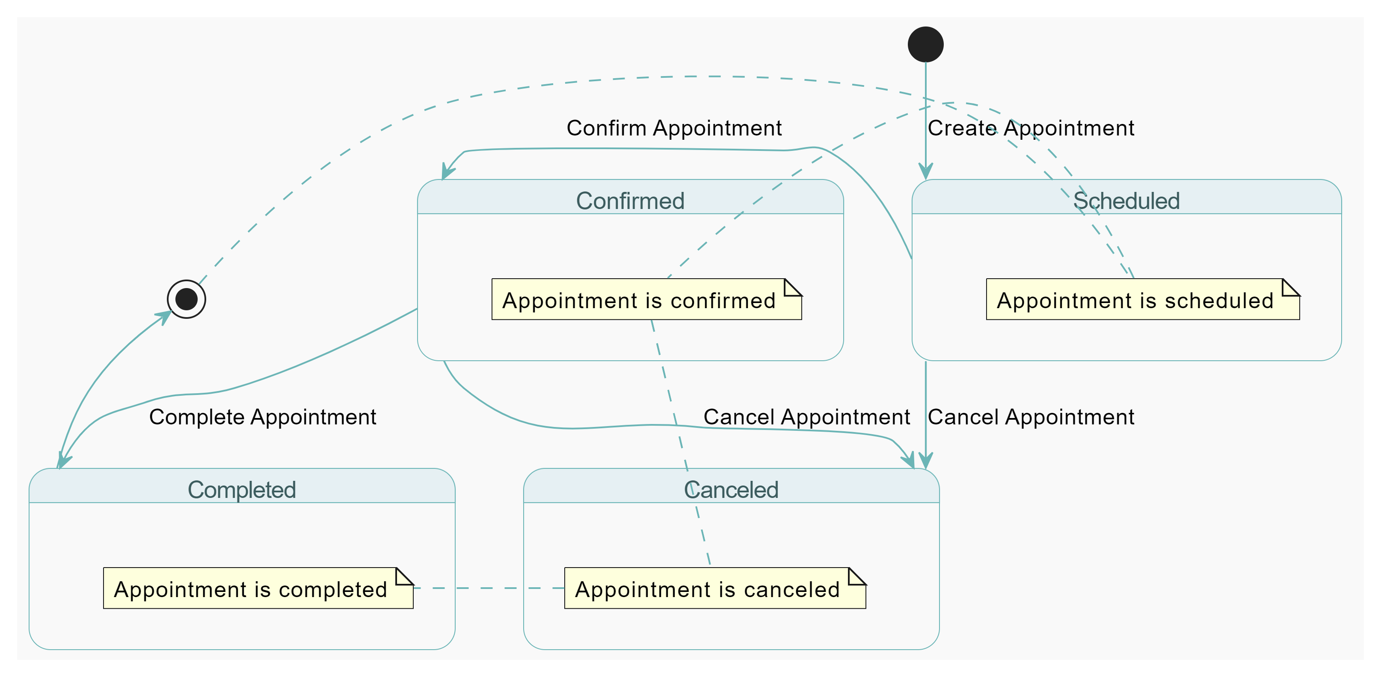
State diagram

Slide 10
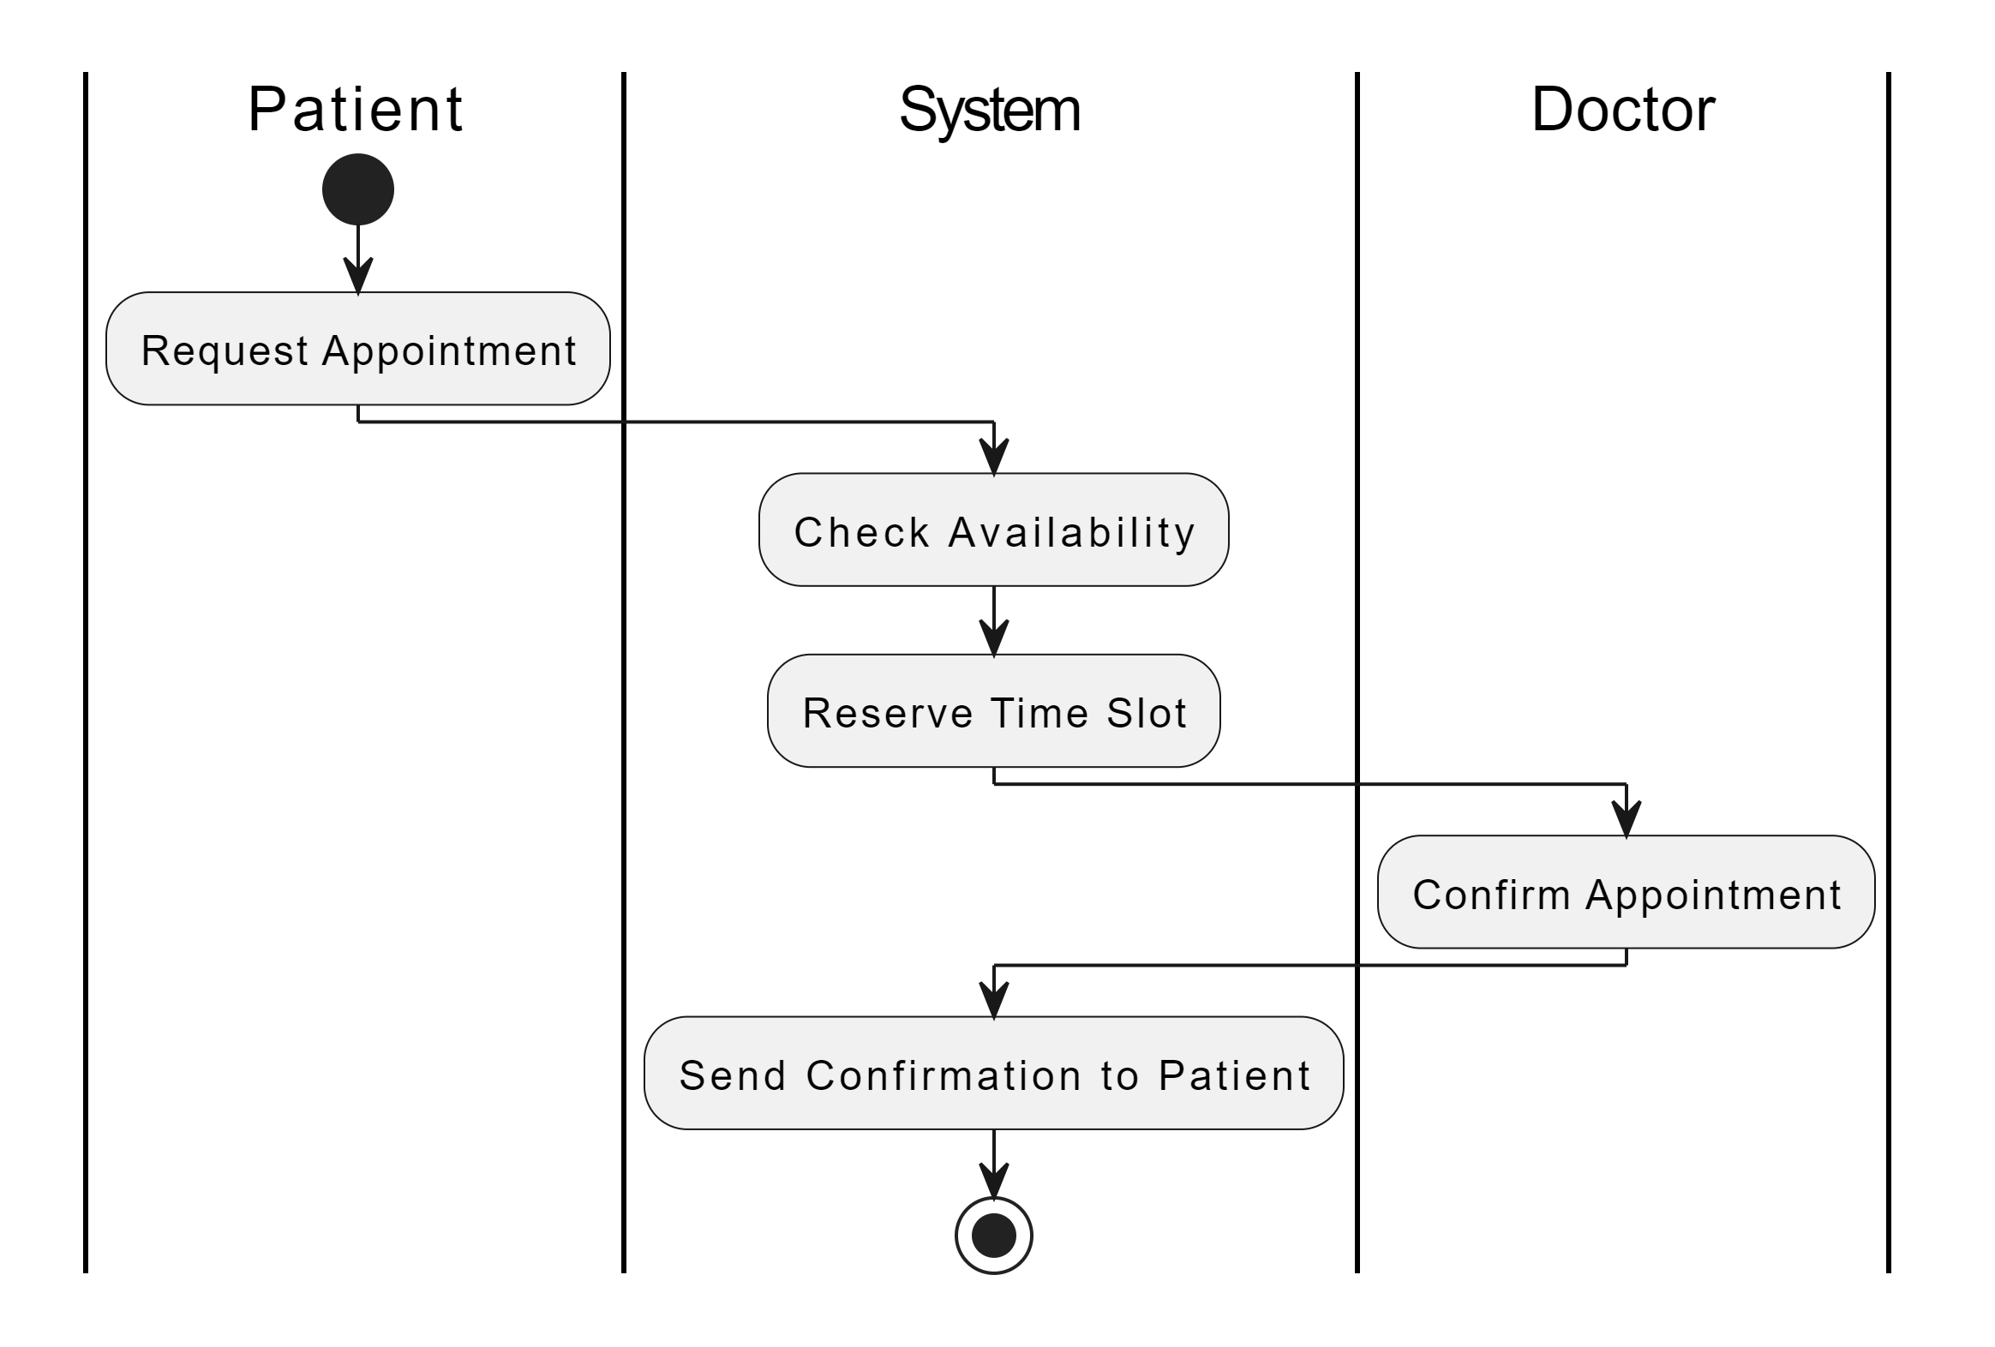
Activity diagram

Slide 11
component diagram

Slide 12
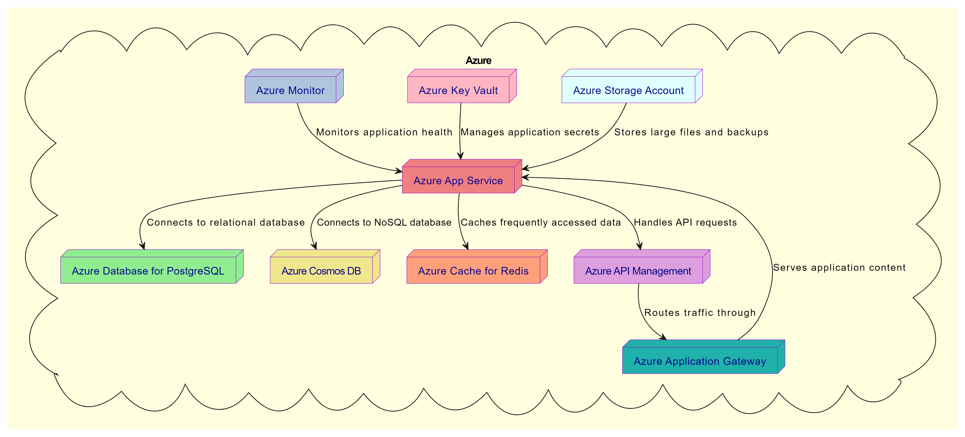
Cloud deploy diagram

Slide 13
Skeleton classes and tables definition
Main Classes
Appointment: Attributes – appointmentID, date, time, doctorID, patientID
MedicalRecord: Attributes – recordID, patientID, history, treatments
Payment: Attributes – paymentID, patientID, amount, date
User: Attributes – userID, name, role
Database Tables
- Appointment Table: Columns for appointmentID, date, time, doctorID, patientID
- MedicalRecord Table: columns for recordID, patientID, history
- Payment Table: Columns for paymentID, patientID, amount, date
- User Table: columns for userID, name, role

Slide 14
Design patterns
GRASP
Controller: Manages operations, like appointment scheduling
Information Expert: Assigns responsibilities to the classes holding the necessary information
SOLID:
- Single Responsibility Principle: Each class has one responsibility (e.g. the Appointment class only handles appointment-related tasks.
- Dependency Inversion Principle: Depend on abstractions, not concretions, making the system easier to modify and extend.
GOF Patterns:
- Factory Pattern: Used for creating objects such as user roles.
- Observer Pattern: Applied for notifying components about changes like appointment status updates.
Microservices:
- Independent Services: Components like appointment management and payment processing are developed and deployed independently for scalability and fault tolerance.

Slide 15
Conclusion and next steps
Key Takeaways:
- The design and implementation of this healthcare management system provided valuable experience in applying Object-Oriented Analysis and Design (OOAD) principles.
- Successfully integrated key components such as appointment scheduling, medical record management, payment processing, and prescription handling into a unified system.
- Utilized UML diagrams and design patterns (GRASP, SOLID, GOF, Microservices) to create a scalable, maintainable, and secure architecture.
Skills Acquired:
Developed a deep understanding of how to design complex, modular systems that meet both functional and non-functional requirements.
Gained practical experience in deploying and managing applications on Azure, including the use of services like App Service, PostgreSQL, Cosmos DB, and Redis.
Learned how to implement security measures and ensure compliance with healthcare regulations such as HIPAA.
Career Benefits:
This project has enhanced my ability to design and implement robust software solutions, a skill that is critical for any software engineering role.
The experience with cloud platforms like Azure positions me well for opportunities in cloud-native development and architecture.
Understanding and applying design patterns and principles has strengthened my ability to create scalable, maintainable, and efficient software systems, which will be beneficial in future software development roles.

